Slide 1
Login & session Management
Dr. Adeel Ansari

Slide 2
Topics to be covered
Login Form & Session Management using ExpressJS

Slide 3
Models/user.model.js
const mongoose=require('mongoose');
const Schema=mongoose.Schema;
let UserSchema=new Schema({
username:{type:String, required:true},
password:{type:String,required:true}
});
module.exports=mongoose.model('User',UserSchema);

Slide 4
Controllers/user.controller.js
const User=require('../models/user.model');
exports.loginchk=function(req, res) {
const {username, password}=req.body; try {
User.findOne({username: username, password:password},(err,user)=>{
if(user ===null){
res.end("Login invalid");
}else if (user.username === req.body.username && user.password === req.body.password){
res.render('completeprofile',{profileData:user});
} else {
console.log("Credentials wrong");
res.end("Login invalid");
}
});
} catch(err) {
res.send(err)
}
};
exports.fetchloginform=function(req, res, next) {
res.render('login', { page:'Login', menuId:'login'});
};

Slide 5
Routes/User.routes.js
const express=require('express');
const router=express.Router();
const user_controller=require('../controllers/user.controller');
//login page
router.get('/login', user_controller.fetchloginform);
router.post('/login', user_controller.loginchk);
module.exports=router;

Slide 6
views/login.ejs
<!DOCTYPE html>
<html lang="en">
<head>
<% include partials/head %>
<style>
.login-form {
width: 300px; margin: 0 auto;font-family: Tahoma, Geneva, sans-serif;
}
.login-form h1 {
text-align: center;color: #4d4d4d; font-size: 24px; padding: 20px 0 20px 0;
}
.login-form input[type="password"],
.login-form input[type="text"],[type="number"] {
width: 100%; padding: 15px; border: 1px solid #dddddd;
margin-bottom: 15px; box-sizing:border-box;
}
.login-form input[type="submit"] {
width: 100%; padding: 15px;background-color: #535b63;
border: 0;box-sizing: border-box;cursor: pointer;
font-weight: bold;color: #ffffff;
}
</style>
</head>

Slide 7
Views/login.ejs
<body>
<% include partials/menu %>
<div class="container-fluid bg-3 text-center">
<h3><%= page %></h3><br>
<div class="login-form">
<form action="./login" method="POST">
<input type="text" name="username" placeholder="username" required>
<input type="password" name="password" placeholder="password" required >
<input type="submit" value="Login">
</form>
</div>
</div>
</body>
<% include partials/script %>
</html>

Slide 8
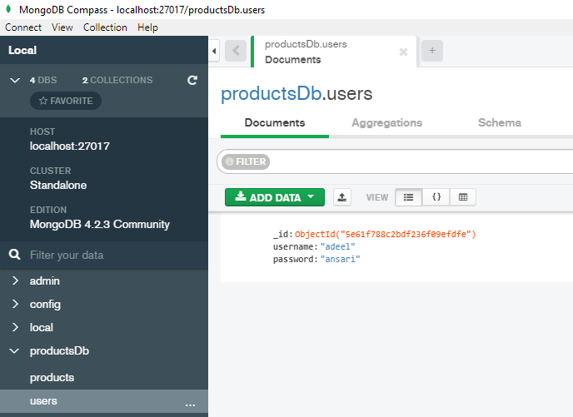
A view of the “users” collection in MongoDb (via Compass)

Slide 9
App.JS
Add these lines in the App.js file, to include the user.routes.js file.
const user=require('./routes/user.routes');
app.use('/users', user);

Slide 10
Session Management
Session handling in any web application is very important and is a must-have feature, without it, we won’t be able to track user and it’s activity.
In Node.js sessions work at application level. When you initialize a session handler object as a middleware in ExpressJS, the request object will share an instance of such handler with all the routes of your application.
The express-session module works in this way. Once a session handler has been created, we can add or remove session variables by simply manipulating a JavaScript object.
npm install --save express-session
The session middleware handles all things for us, i.e., creating the session, setting the session cookie and creating the session object in req object.

Slide 11
Create Session object in app.js
const session = require('express-session');
app.use(session(
{secret: 'random message', //this is needed for making a session key
saveUninitialized: false, //for login sessions set it to false, setting to true means store blank sessions
resave: false,
cookie: {
expires: 600000 //or use maxAge ( takes in milliseconds value)
}
}
)
);

Slide 12
User.controller.js
exports.loginchk=function(req, res) {
const {username, password}=req.body;
try {
User.findOne({username: username, password:password},(err,user)=>{
if(user ===null){
res.end("Login invalid");
}else if (user.username === username && user.password === password){
req.session.username=username;
res.locals.username=username;
res.render('dashboard',{ page:'Dashboard', menuId:'dashboard', session:req.session});
console.log("Creating session for: " +req.session.username);
} else {
console.log("Credentials wrong");
res.end("Login invalid");
}
});
} catch(err) {
res.send(err)
}
};

Slide 13
Dashboard.ejs (Call session in ejs view file)
<body>
<% include partials/menu1 %>
<div class="container-fluid bg-3 text-center">
<h3><%= page %></h3><br>
Greetings <%= session.username %>
</div>
</body>
<% include partials/script %>
</html>

Slide 14
Destroy Session (for logout)
exports.logout=function(req, res, next) {
req.session.destroy((err) => {//destroy all sessions
if(err) {
return console.log(err);
}else{
console.log('Destroying session');
}
res.redirect('/users/login');
});
};

Slide 15
Source code

Slide 16
Reference
https://www.tutorialspoint.com/mongodb/index.htm
https://codeburst.io/writing-a-crud-app-with-node-js-and-mongodb-e0827cbbdafb
https://medium.com/@bhanushali.mahesh3/creating-a-simple-website-with-node-js-express-and-ejs-view-engine-856382a4578f
https://www.codementor.io/@mayowa.a/how-to-build-a-simple-session-based-authentication-system-with-nodejs-from-scratch-6vn67mcy3

